Slide 1
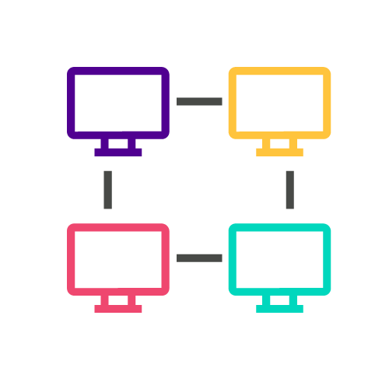
COLT-X: The Use of AI for Network Automation and Network Optimization
Colt Technology Services
Berkeley Innovation X-Labs
Sutardja Center for Entrepreneurship & Technology

Slide 2
Appendix
About Colt
What Colt Provides
Project Scope
Objective
Technical Phases
System Architecture
Low Tech Demo
Platform Selection
UI Requirements
Final Demo
Technical Components
Technology Strategy
Project Timeline
Next Steps
Future Work
Reflections
Meet the Team
Skylight Performance

Slide 3
About Colt Technology Services
Provides world-class network & voice connectivity to businesses in Europe, Asia & the US
Connects 900+ data centres across Europe, Asia & North America
Takes advantage of emerging technologies (i.e. SD-WAN, 5G deployments, or uCPE)

Slide 4
What Colt Provides
Capital market solutions
Optical network and ethernet services
On Demand network solutions
Services
Internet, SD WAN, & IP VPN
Cloud & data center services
Cybersecurity services

Slide 5
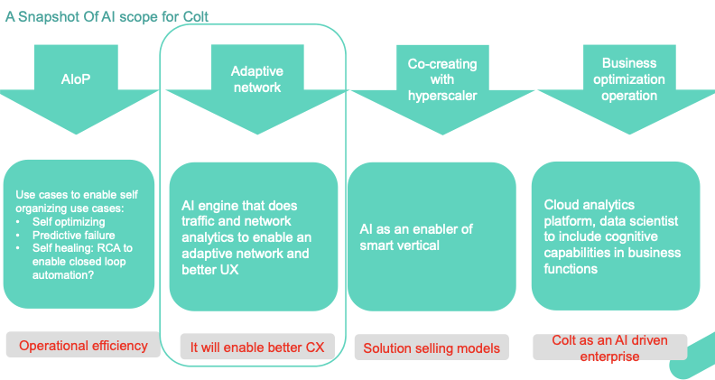
Snapshot of AI Scope from Colt

Slide 6
Objective: Dynamically Set Bandwidth in AR/VR Applications
01
02
03
Network Traffic Data
Analyze network traffic behavior and hourly changes
Dynamically Set Bandwidth
Provide bandwidth levels over an hourly period throughout each day
SLA Characterization
Tell characterization and pull what the application is doing

Slide 7















System Architecture: Colt Application-Centric Network
Skylight Performance Analytics (Accedian)
COLT Novitas Portal: On-Demand Live Portal
(Bandwidth changes)
https://ondemand.colt.net
Algorithm Prototyping:
Optimized bandwidth
Dynamic SLA Mathematical Computations
Stats including mean, variance, etc.
Statistical Multiplexing (see application)
Storage:
Short: Apache Zeppelin (Python/R)
Long: .csv files
Existing UI Interface used by Colt
Data extraction
MEASURE
CONTROL
Phase 1&2 PROCESSES
Feedback from Colt
OUTPUT: SERVER
New settings (Bandwidth)
Graph of network and measures of current Quality of Service (QOS)
Network delays experienced on link
Display the measurement and characterization of Dynamic SLAs
INPUT: APPLICATION
Network traffic data collected from probes placed against AR/VR applications
Log event data
LINK Pipeline (Bandwidth)

Slide 8
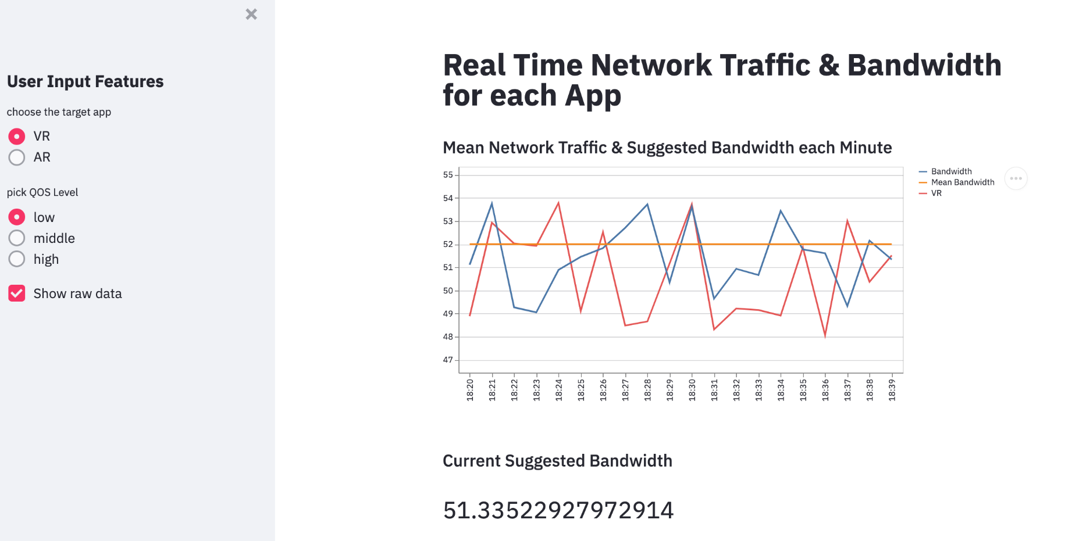
Low Tech Demo

Slide 9
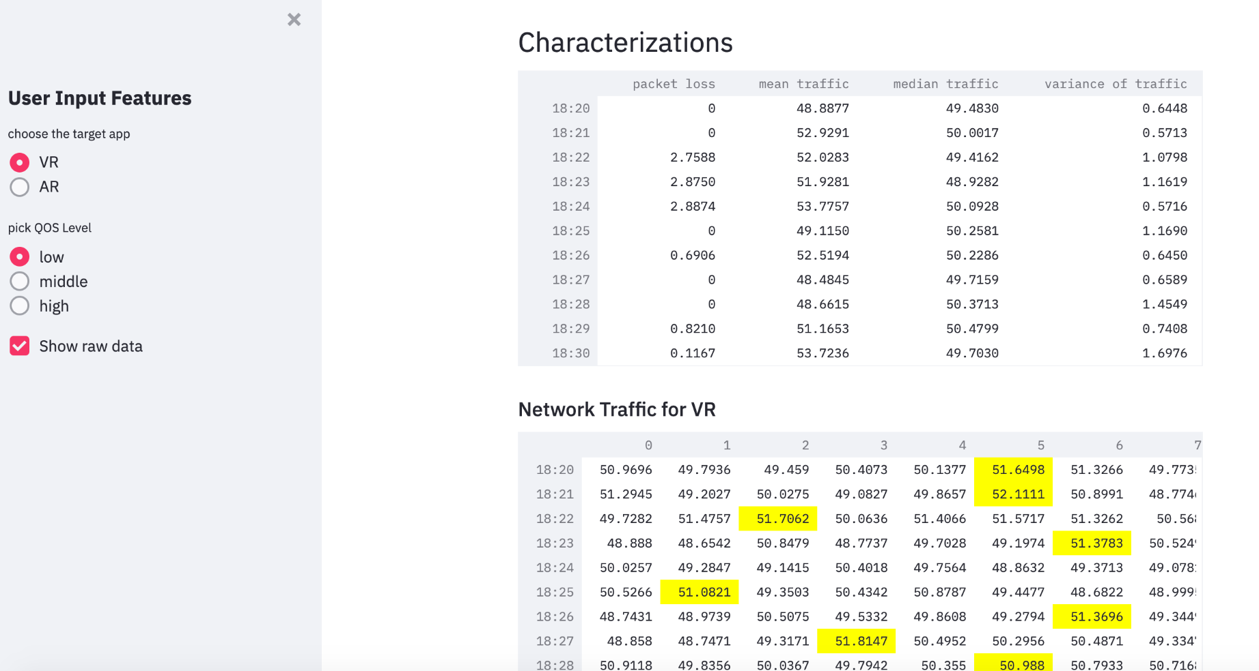
Low Tech Demo

Slide 10
Platform Selection
Need from platform:
UI that displays automatic network bandwidth settings through data visualizations and dynamic characterizations of SLA
Front-end web application using Python
Allows the user to upload data files
Deployed anywhere
Collaborative through Git version control or generating a shareable link
Free license for Berkeley students or staff
Feasible with Jupyter
Why Anvil?

Slide 11
UI Requirements
Allows for csv file uploads
Chooses the target app from VR to AR
Picks QOS level from low to high (1-5)
INPUT
User Interface
OUTPUT
Determines a new bandwidth
Shows mean network traffic of the current bandwidth per minute on a line graph
Displays tables for characterization & VR network traffic

Slide 12
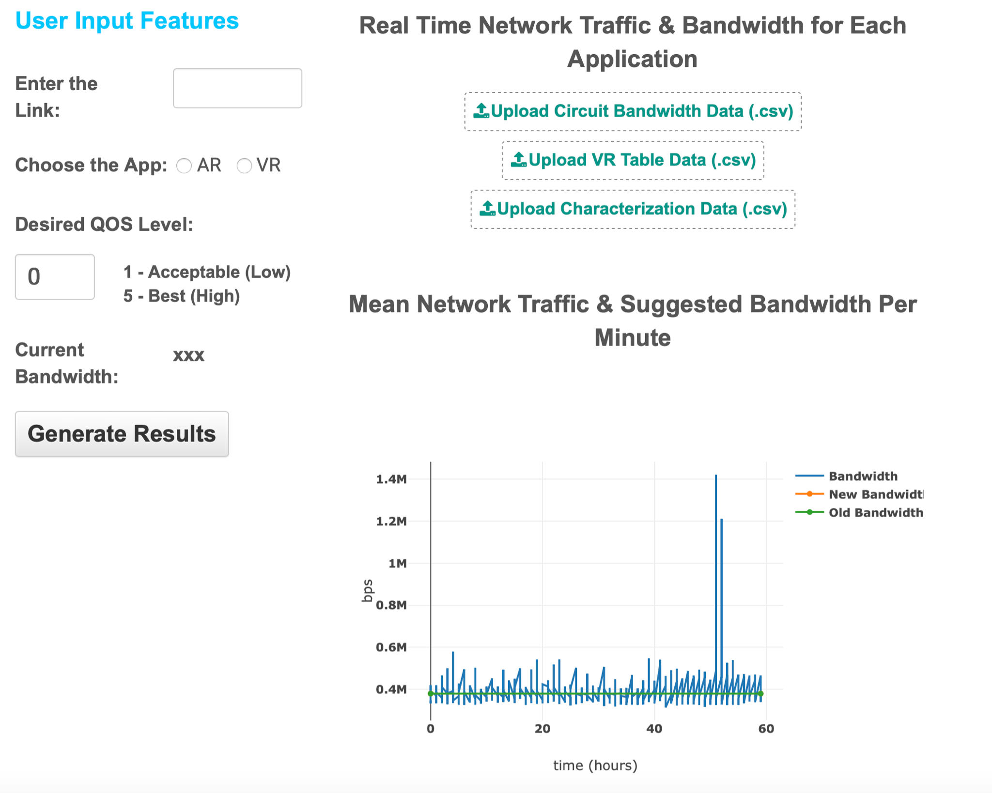
Final Demo
Mathematical Computations
QOS =
Low → β=1 → μ + 1*σ
Mid → β=3 → μ + 3*σ
High → β=5 → μ + 5*σ

Slide 13
Technical Components
Order of importance:
Python and relevant libraries (matplotlib, plotly, numpy scipy, etc.)
Technologies for UI component: Streamlit, Anvil, Git
DEMO with analytics partner (Accedian): real time effect of changing bandwidth performance in test environment
Access to available data through Skylight Analytics (Accedian)
UI component: Valuable information to display based on Colt’s preferences
Algorithmic prototyping and mathematical computations. Resource: Ikhlaq Sidhu
Green & Orange: Easy to develop
Red: Learning required (complete)

Slide 14


Technology Strategy Analysis
Platform | Flexibility & Speed of Iteration | Ease of Use / Learning Curve | Performance | Overall Rating
 | Quick | easy; documents; basic python coding | good for data analysis & display; lacks powerful UI features | 7
 | Quick | medium; video & docs; more components (client codes) | good for heavy backend code; more features; average UI | 9

Slide 15
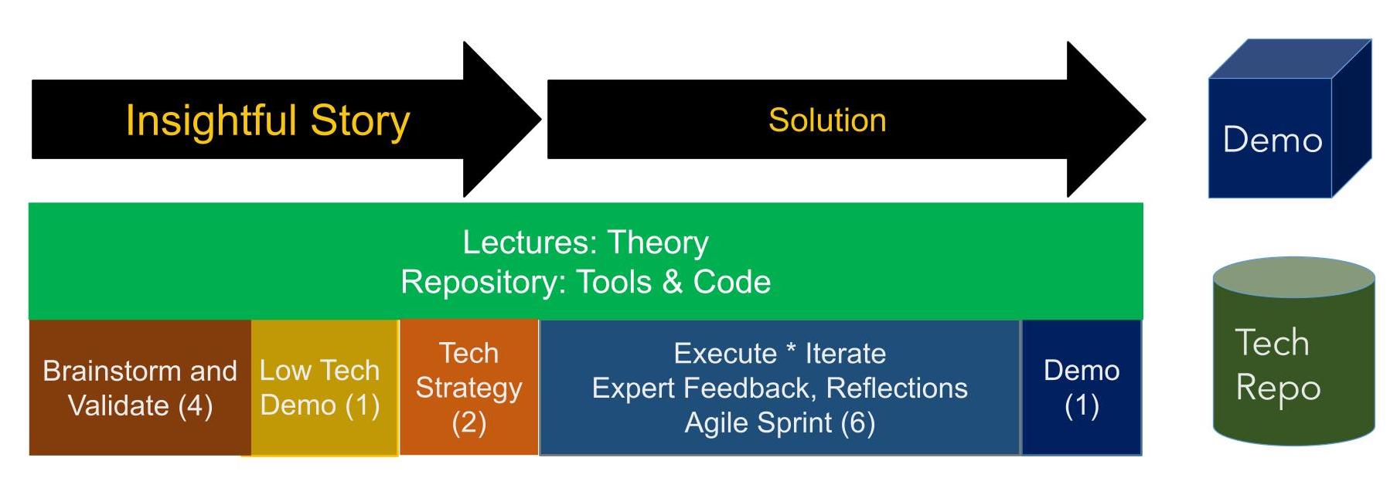
Project Timeline
Brainstorm/Project Story with Colt Mentor (Week 1)
Low Tech Demo v1 (Week 2)
Low Tech Demo v2 (Week 3)
Technology Strategy (Week 4)
Low Tech Demo complete with tech strategy v3 (Week 5)
Execution in 4 Weekly Sprints (Week 6-10)
Demo, Presentation, and Scope of next project (Week 11)
Final Demo, Presentation, and Scope of next project (Week 12)

Slide 16
Next Steps
Completed (Phase 1)
Information about network traffic data and performance
Uploading Circuit Bandwidth table, VR table, Characterization data
Link
AR/VR app selection
Desired QOS Level
Current Bandwidth
Mean Network Traffic & Optimized bandwidth suggestion Per Minute graph
Network Traffic Table for VR
Characterization Table
Next Steps (Phase 2)
Some features not functionally implemented
Link
AR/VR app selection
Writing tests to check how quickly the bandwidth should change based on model recommendation
Map what QOS setting equates to low and high quality AR/VR service
Notes:
https://anvil.works/build#clone:WFUL66I32H4E7CDH=DW3P3JFWHII4VMGTBBBXKTD2

Slide 17
Algorithm 2.0: Future Work
Connect the network to application through link- not functionally implemented
AR/VR application selection display (if multiple apps on one link)
Filtering csv files- should display data for any timeframe
How often you readjust: if the model says to re-adjust it how quickly does it go up and down
Algorithm test that pulls the bandwidth down and checks it against current setting
Show through dotted line on graph
Characterization (what a 3 vs 1 means) in terms of AR/VR stream app
Map what QOS setting equates to low and high quality AR/VR service
Characterization and measurement of dynamic SLA

Slide 18
Reflections
What we learned, what was unexpected, takeaways from project experience, etc.

Slide 19






Meet the Innovation-X Team
Isabel Zavian
Management Lead
B.A. Economics & Data Science
izavian@berkeley.edu
Noor-Ul-Ain Ali
Technical Lead
B.A. Data Science
noorulain@berkeley.edu
Ronel Solomon
Technical Member
B.A. Data Science
ronelsolomon@berkeley.edu
Charline Shen
Intern
B.A. Computer Science & Physics
tingweishen@berkeley.edu
Andy Lam
Intern
B.S. Mechanical Engineering
alam9414@berkeley.edu
Peter Li
Intern
B.A. Applied Math & Computer Science
lixingyu@berkeley.edu

Slide 20

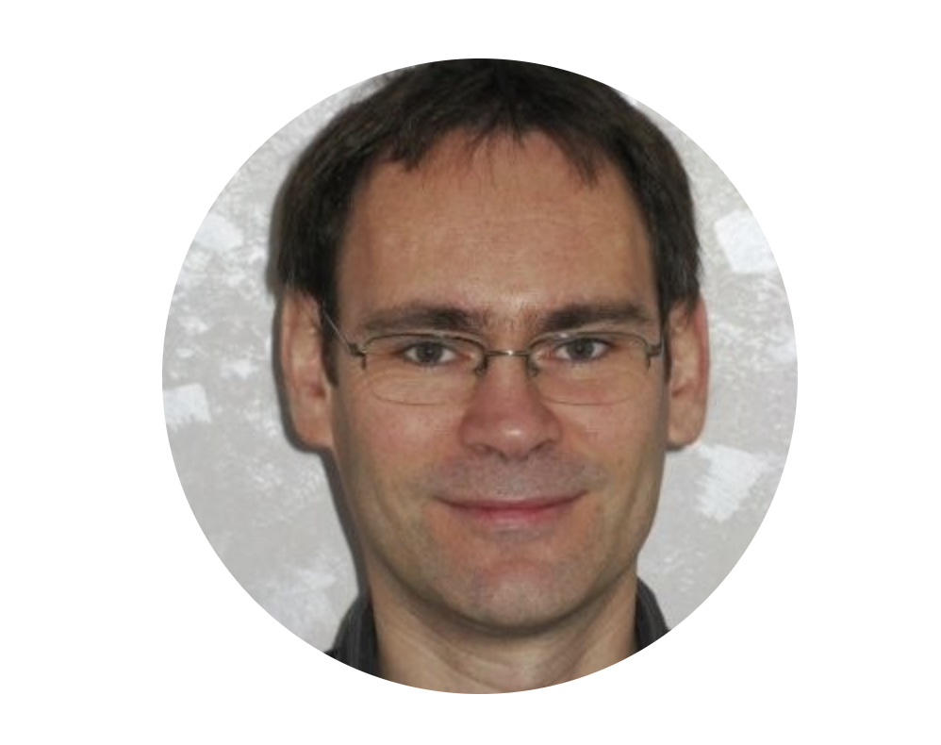




Advisors
Francesca Serravalle
Emerging Technology Director
COLT Technology Services
Valéry Augais
Network Architect
COLT Technology Services
Elisa Balestra
Project Manager
Berkeley Innovation-X Labs
Debashis Chatterjee
Senior Director of Software Engineering
Intel Corporation
Ikhlaq Sidhu
Founding Chief Scientist & Faculty Director
Sutardja Center for Entrepreneurship & Technology
Jennifer Nice
Director of Industry & Alumni Relations
Sutardja Center for Entrepreneurship & Technology

Slide 21
Thank You!
Do you have any questions?
Innovation-X: https://innox.berkeley.edu
Colt: https://www.colt.net

Slide 22
Skylight Performance Analytics
Accedian Documentation

Slide 23
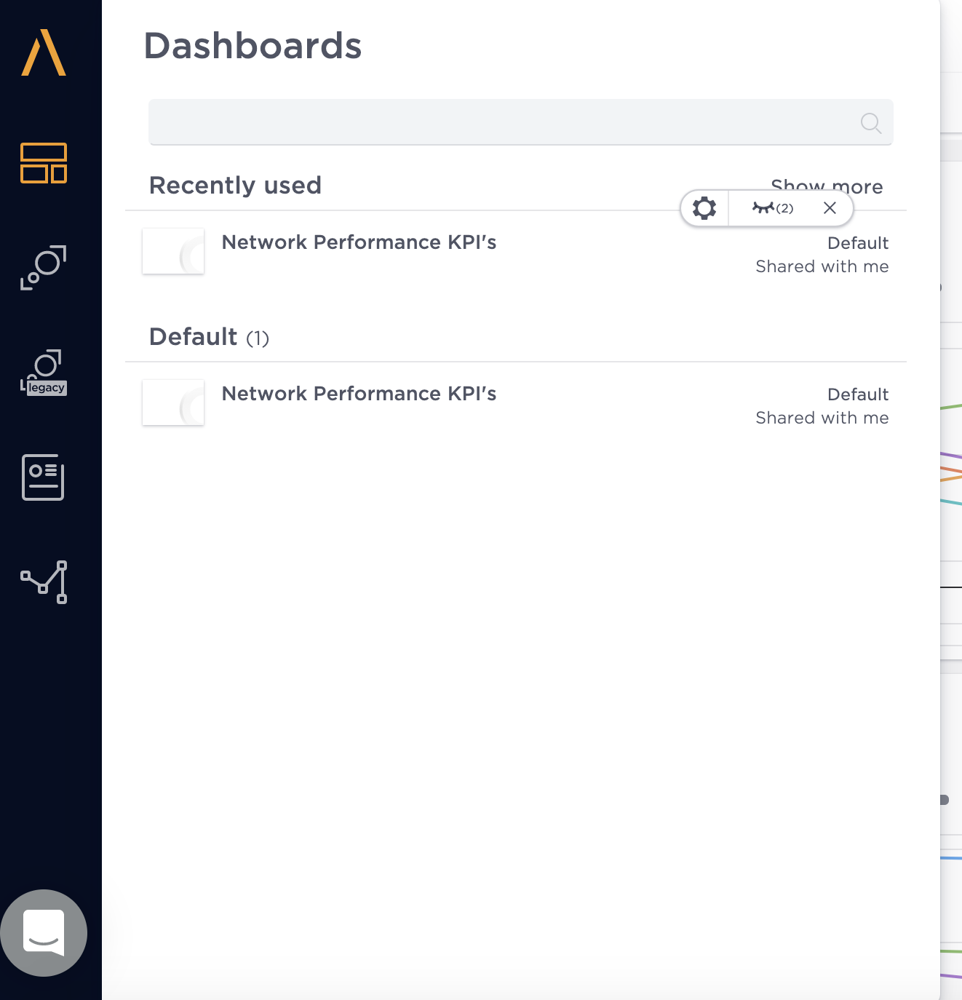
Choose a Dashboard
You can first choose your main dashboard in the Monitoring section.

Slide 24
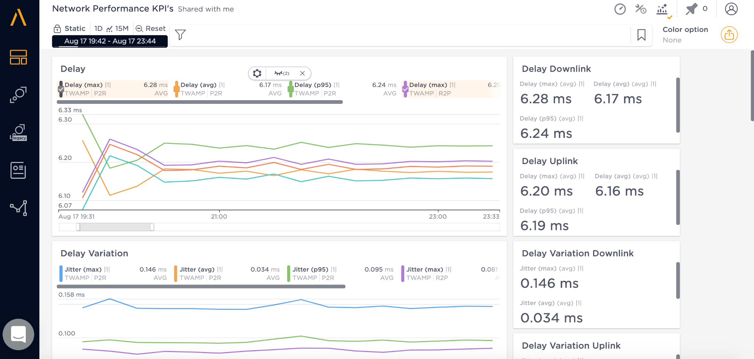
Main Dashboard
Change the time zone here
Zoom the graph here
List of characterizations

Slide 25
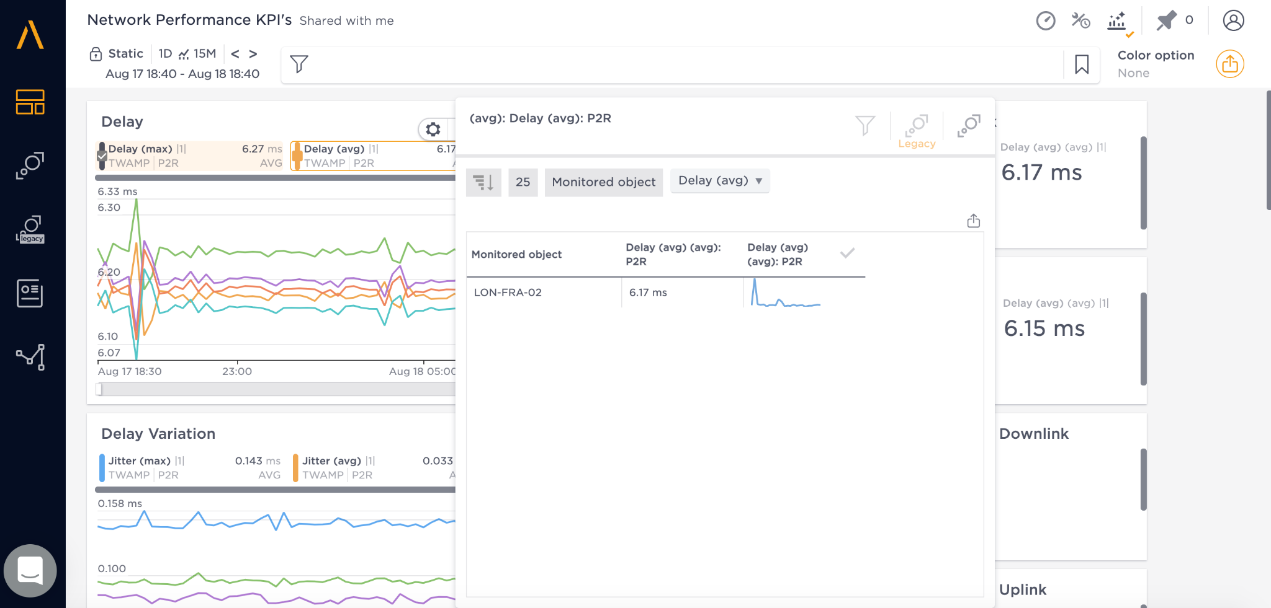
Main Dashboard
Click on the arrow on the right of any metric block to expand
Click on the monitored object to look closely at the object’s data & metrics.

Slide 26
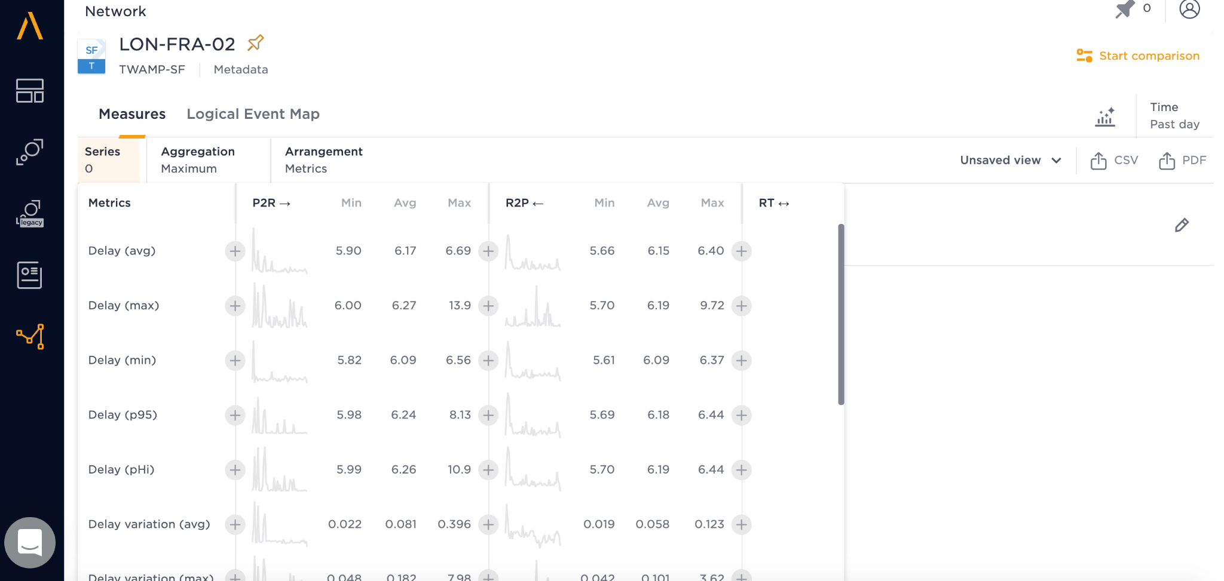
In a Network Object
Inside a target network object, we can click on Series Button and add the metrics we want by clicking the “+” button beside.

Slide 27
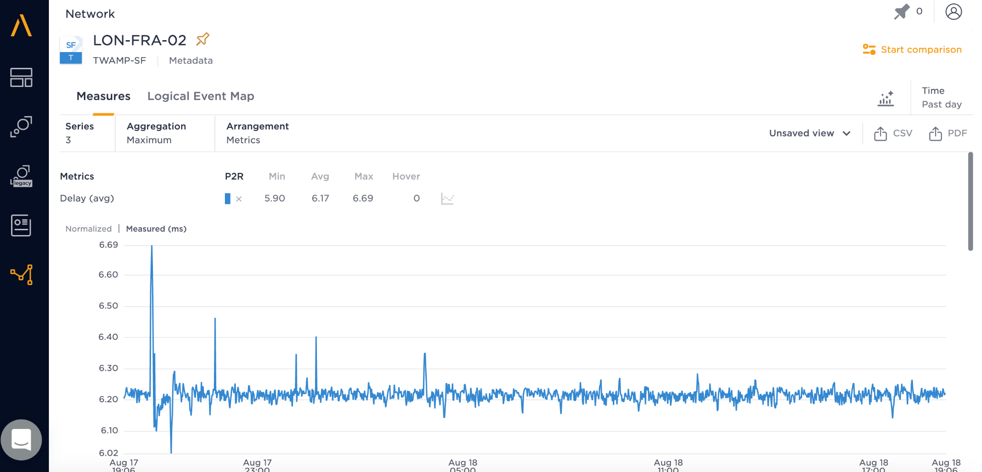
In a Network Object
After adding the metrics, you can download the csv/pdf data here.

Slide 28
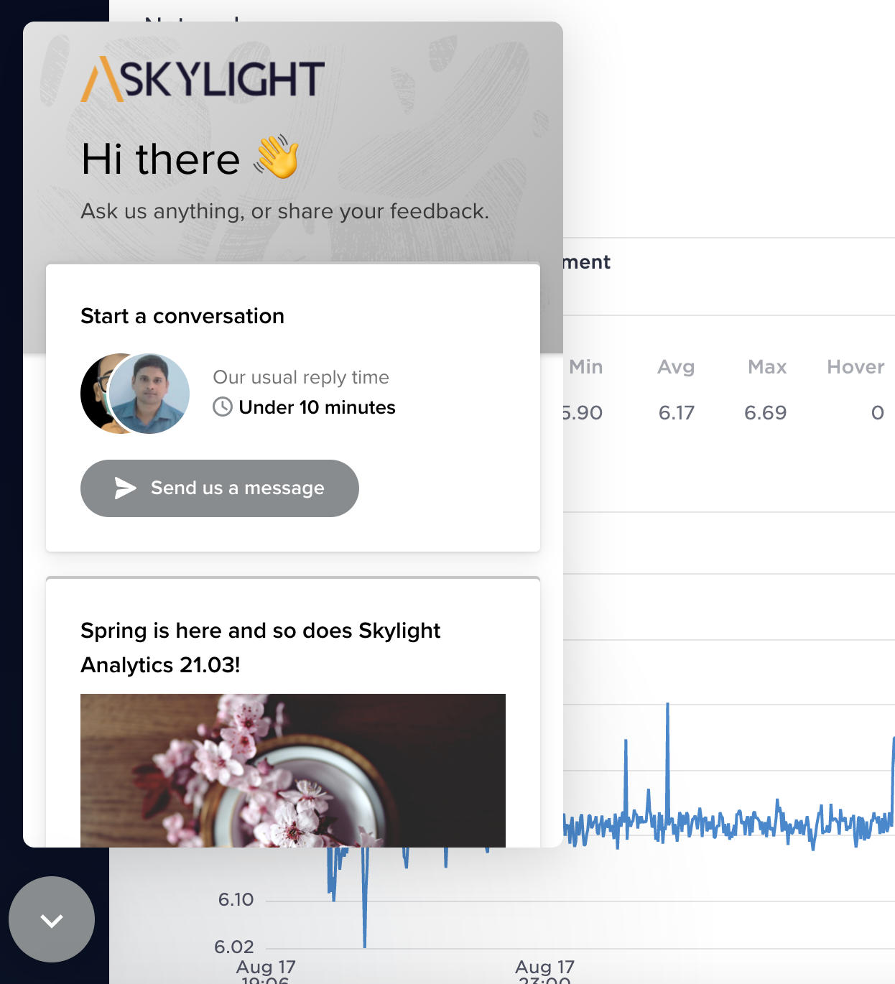
Chat Window
You can click on the arrow at the bottom left corner to talk with Skylight staffs.

